Slide 1

Sign Up

Slide 2
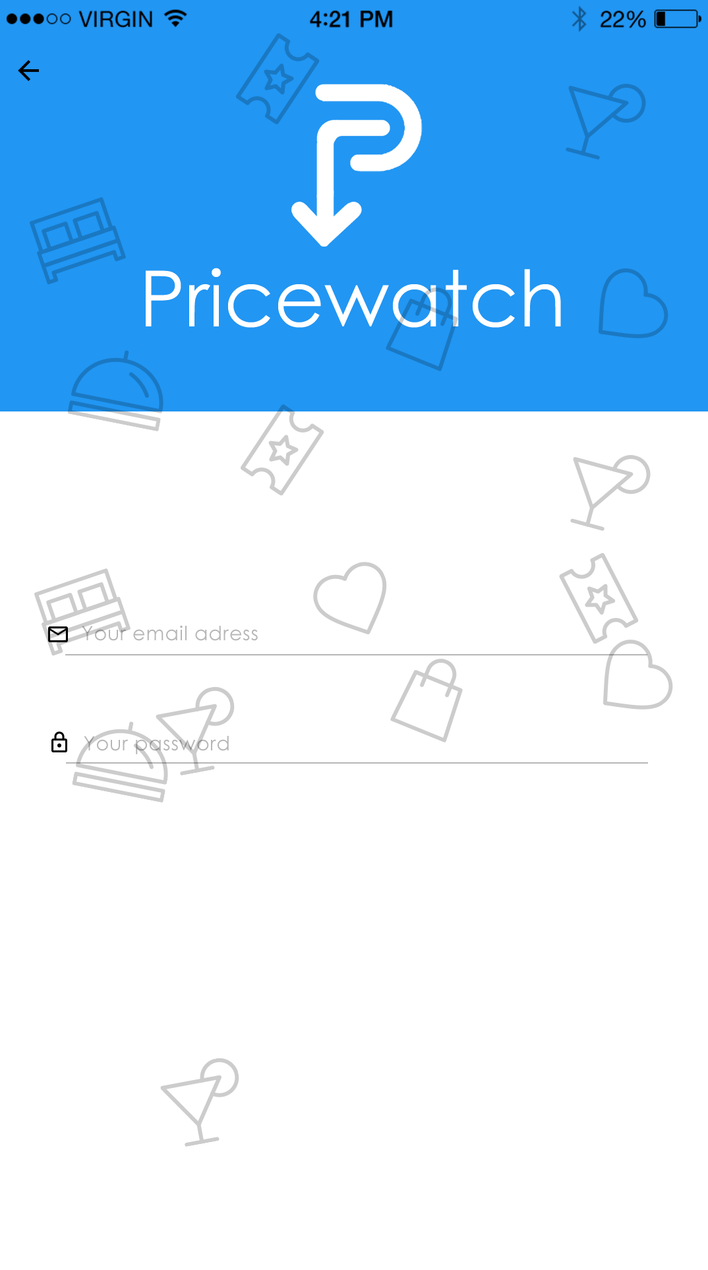

Create Account
Sign in with Facebook

Slide 3
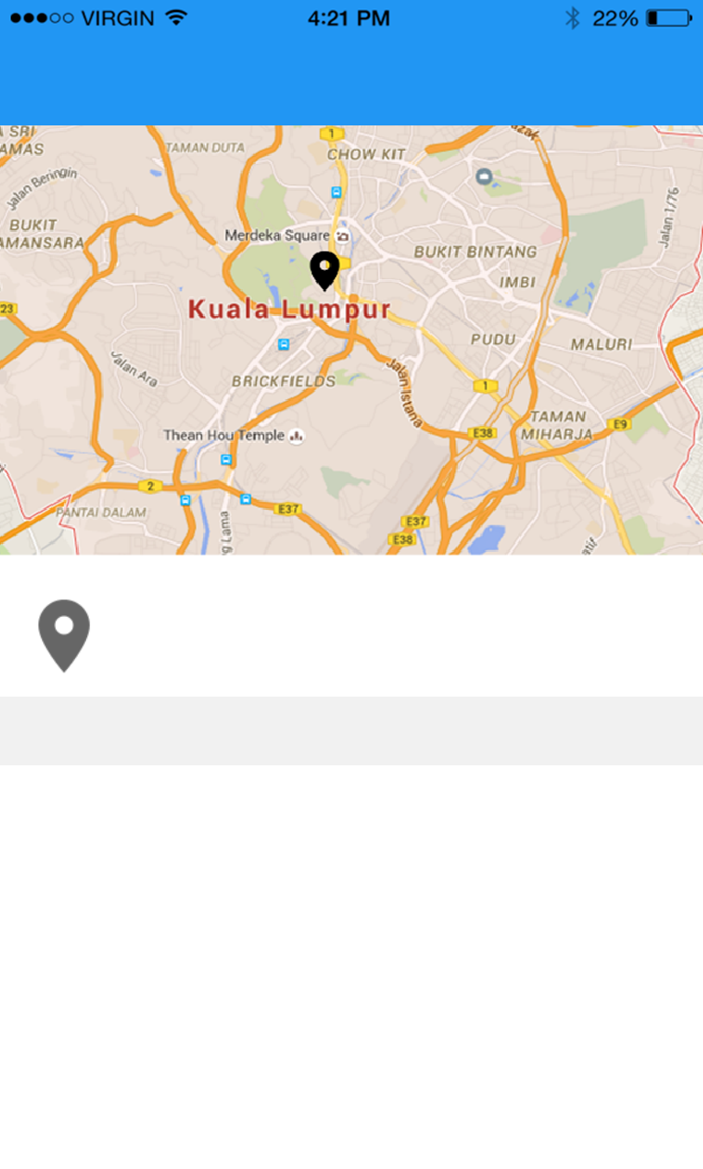

Tell us your location
Select this location
Jalan Ayam, 213000, Kuala Lumpur
NEARBY PLACES
Bukit Bintang
Jalan Bukit Bintang, Kuala Lumpur
Pudu
Jalan Pudu, Kuala Lumpur
Brickfields
Jalan Tun Sambathan, Brickfields

Slide 4
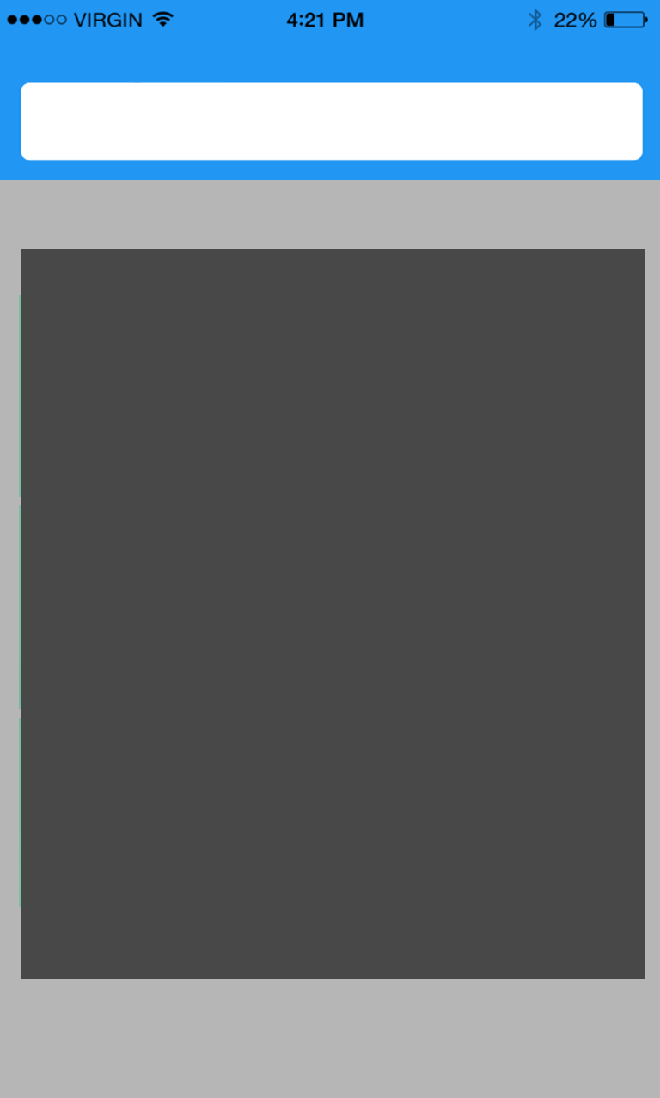

What would you like to buy?
Browse groceries by categories
Recent items
No items yet. Add items using the search.
Fish & Meat
Beverages
Bread & Bakery
Canned & Jarred Goods
Snacks
Dry & Baking Goods
Dairy
Fruits & Vegetables
Lets compare!

Slide 5

What would you like to buy?
Browse groceries by categories
Recent items
No items yet. Add items using the search.
Keropok Sira
Sardin 100ML
Chicken Nugget
Milo 500ML
Friskies 100ML
Sardin 250ML
Fish & Meat
Beverages
Bread & Bakery
Canned & Jarred Goods
Lets compare!

Slide 6
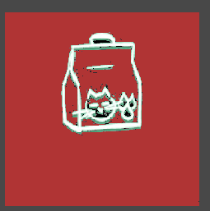
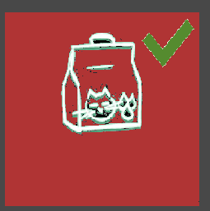

What would you like to buy?
Browse groceries by categories
Recent items
No items yet. Add items using the search.
Keropok Sira
Sardin 100ML
Chicken Nugget
Chicken Nugget
Milo 500ML
Friskies 100ML
Sardin 250ML
Fish & Meat
Beverages
Bread & Bakery
Canned & Jarred Goods
Lets compare!

Slide 7
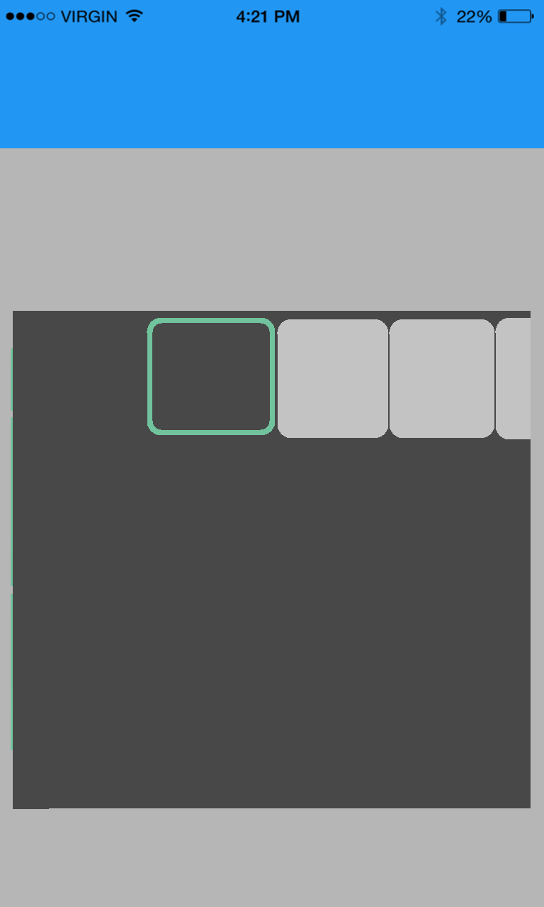


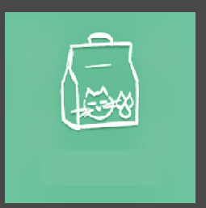


You save about RM10.00!
Your groceries are cheaper if you shop at :
Giant Pudu
Giant Pudu
AEON
Brickfields
TESCO
Pudu
RM10.20
RM15.20
RM15.20
Chicken Nugget
RM20.20
RM25.20
RM25.20
MILO 500ML
Total : RM30.40
Copy to clipboard
Share your list

